Slide 1

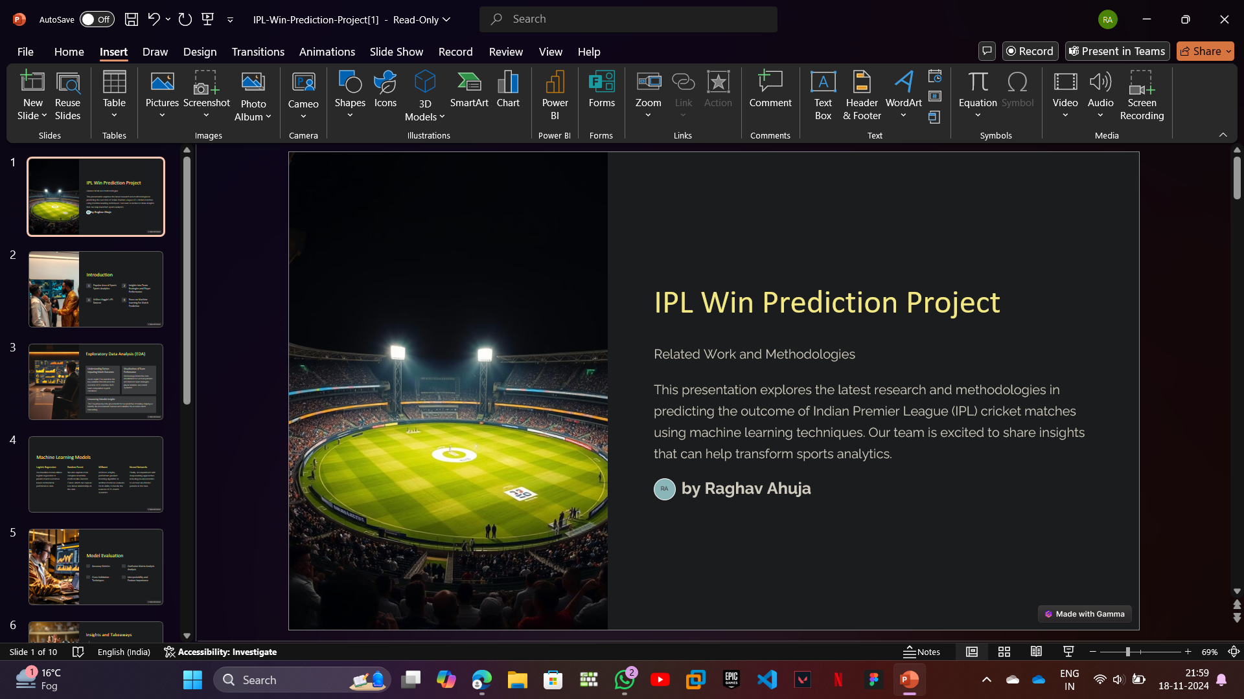
IPL Win Prediction Project
Related Work and Methodologies
This presentation explores the latest research and methodologies in predicting the outcome of Indian Premier League (IPL) cricket matches using machine learning techniques. Our team is excited to share insights that can help transform sports analytics.

Slide 2

Introduction
1
Popular Area of Sports Analytics
2
Insights Into Team Strategies and Player Performance
3
Utilizes Kaggle's IPL Dataset
4
Focus on Machine Learning for Match Prediction

Slide 3

Predicting IPL Player Performance with Machine Learning
- Applied logistic regression and random forest models to forecast IPL player performance. - Experimented with gradient boosting and neural networks to explore more advanced techniques. - Tested model stability by evaluating performance across multiple IPL seasons.

Slide 4

Exploratory Data Analysis (EDA)
Understanding Factors Impacting Match Outcomes
Visualizations of Team Performance
We leverage interactive data visualizations to uncover patterns and trends in team strategies, player statistics, and match dynamics.
Our in-depth EDA examines the key variables that influence the outcome of IPL matches, from team composition to pitch conditions.
Uncovering Valuable Insights
The EDA phase lays the groundwork for our predictive modeling, helping us identify the most relevant features and variables for accurate match forecasting.

Slide 5
Machine Learning Models
Logistic Regression
Random Forest
Our baseline model utilizes logistic regression to predict match outcomes based on historical performance data.
We also explore more complex ensemble methods like Random Forest, which can capture non-linear relationships in the data.

Slide 6
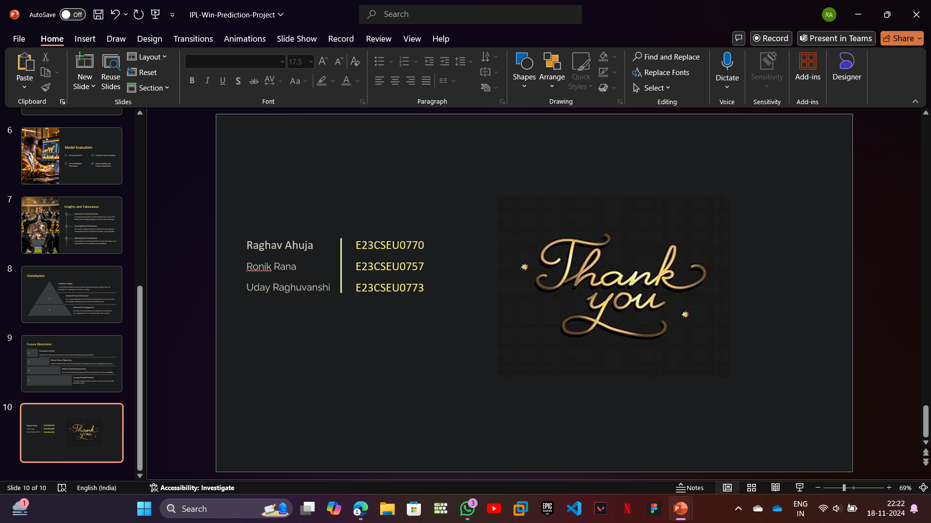
Logistic Regression over Random Forest
Simplicity: Logistic regression is simpler to implement and interpret compared to more complex models.
Efficiency: It requires less computational power and time, making it suitable for smaller datasets or real-time predictions.
Interpretability: Coefficients in logistic regression provide direct insights into the relationship between predictors and outcomes.
Performance on Linearly Separable Data: Logistic regression works well if the data is linearly separable or close to it.
Avoidance of Overfitting: With regularization techniques (e.g., L1 or L2), logistic regression can effectively prevent overfitting.

Slide 7
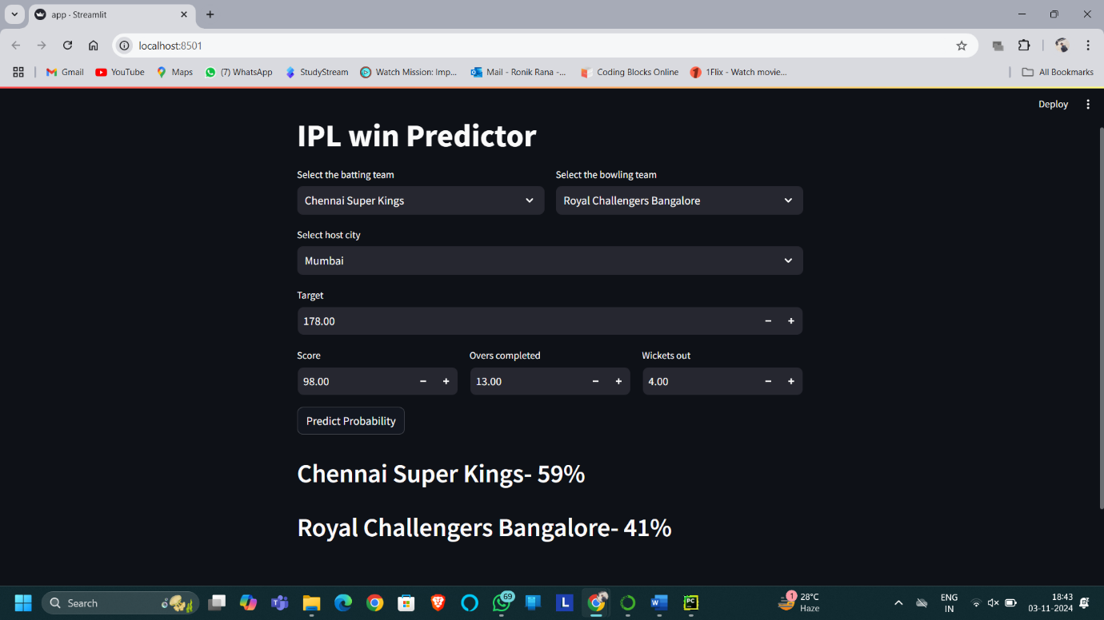

Slide 8

Model Evaluation
Accuracy Metrics
Confusion Matrix Analysis
Cross-Validation Techniques
Interpretability and Feature Importance

Slide 9

Insights and Takeaways
1
Key Factors for Match Outcomes
Our analysis reveals the most influential factors, such as team batting order, bowling strategies, and home field advantage.
2
Surprising Player Performances
We uncover unexpected player contributions that challenge conventional wisdom and provide valuable scouting insights.
3
Optimizing Team Compositions
The predictive models help identify the ideal team balance and roster selections for maximizing win probabilities.

Slide 10



Conclusion
Predictive Insights
1
Our machine learning models provide valuable predictive insights that can transform IPL strategy and decision-making.
Improved Team Performance
2
By understanding the key factors influencing match outcomes, teams can optimize their lineups and tactics for better results.
Enhanced Fan Engagement
3
Accurate match predictions can elevate the excitement and engagement of IPL fans throughout the season.

Slide 11
Future Directions
Incorporate Live Data
1
Expand the model to process real-time match data and provide in-game predictions.
Enhance Feature Engineering
2
Explore additional data sources and develop more sophisticated feature engineering techniques.
Optimize Model Hyperparameters
3
Fine-tune the machine learning models for even greater accuracy and reliability.
Leverage Ensemble Methods
4
Combine multiple models to create a more robust and versatile predictive system.

Slide 12
E23CSEU0770
Raghav Ahuja
E23CSEU0773
Ronik Rana
E23CSEU0757
Uday Raghuvanshi

